Slide 1
The Farakka Barrage Project: Historical and Technical Details
Jenia Mukherjee
Department of Humanities and Social Sciences
IIT KHARAGPUR

Slide 2
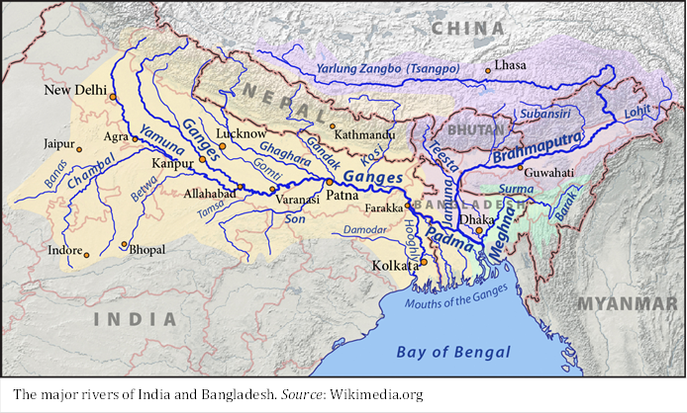
Farakka
Notes:
This is Farakka which is part of the LGB. We will be discussing the FBP, mainly focusing on historical and technical details in this lecture followed by social and environmental implications of the project in upstream and downstream districts i.e. Malda and Murshidabad respectively in the next presentation.

Slide 3
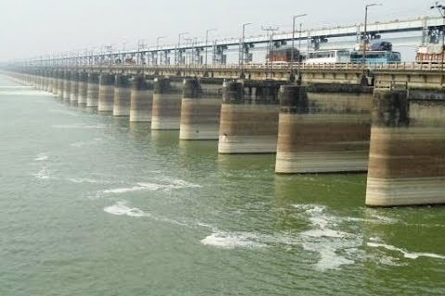
The Farakka Barrage
Notes:
The FB is a big and laudable project and it comprises of 112 lock gates. Apart from technicalities and implications of the project, it is thickly loaded with history, environmental history of the LGB. Here, in this presentation we will focus on both historical and technical details of the project.

Slide 4
Why the Farakka Barrage Project?
Transboundary dismension
Explorations from the Bangladesh perspective
Indian (West Bengal) scenario under explored
The Lower Gangetic Basin – nebulous, fluid, hybrid space
Personal exposure – field observations and findings
Notes:
What happens when big interventions occur at nebulous, deltaic-estuarine land(water)scape?

Slide 5
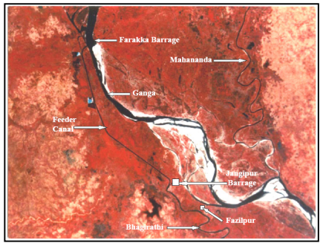
Components and Implementation
1961 – commencement
The project complex:
  Farakka Barrage
  Feeder Canal
  Jangipur Barrage
  Navigation Lock and
  associated structures
Source: Rudra 2003
Notes:
The Farakka Barrage Project Authority was set up in 1961 with the mandate to execute and thereafter operate and maintain the Farakka Barrage Project Complex comprising of Farakka Barrage, Jangipur Barrage, Feeder Canal, Navigation Lock and associated structures.
Foundation of the project was laid down by work began in 1962 and was completed in 1971. The excavation of 38.3 km long feeder canal took another four years.
The induced water through Ganges-Bhagirathi feeder canal was supposed to flush the sediment load from the estuary and keep the navigation channel free from siltation.
Completion of feeder canal ensures the following additional benefits: i) Improvement of water supply for Calcutta and its industrial area by reduction in salinity. ii) Improvement of drainage capacity of the Bhagirathi and upper Hugh and reduction of flood hazards in the catchment area. iii) Improvement in sanitation and public health. iv) Extension of navigability in the Bhagirathi and Ganga from Calcutta to Uttar Pradesh through feeder canal.
This barrage has been provided to prevent the feeder canal water, flowing back into the Ganga and for regulating the direct in flow from the Bhagirathi head.
The formal inauguration of the project was held on 21st May 1975.
The 2.64 km long Farakka Barrage through 38.38 km long feeder canal was designed to divert 40,000 cusecs (1133 cumec) of Ganga water towards Bhagirathi so that the navigational status of the Calcutta Port could be resuscitated.

Slide 6
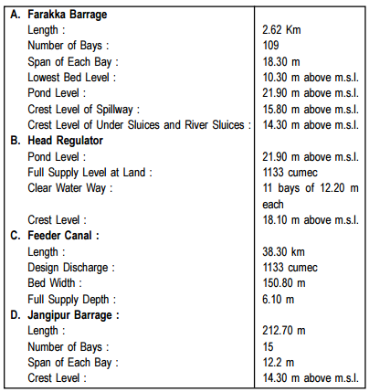

Slide 7
The Historical Context
1853 – Sir Atherton
1896 – Vernon Harcourt
1913 – Reak
1916-19 – Stevenson-Moore Committee
1930 – William Willcocks
1939 = T.M. Oag
1946 – A. Webster
1957 – Walter Henson
Boundary Commission – deviation from the religious principle (MEA 1978)
Notes:
From the middle of the nineteenth century, the British became anxious about the future of the Calcutta Port and started thinking about the feasibility of an alternative port construction. Port Canning was constructed between 1865 and 1866. But due to the problem of sediment accumulation, this port also had a limited lifeline till 1871. The plan for the construction of a barrage on Ganges near Rajmahal and the creation of a feeder canal to bring the surplus water from the Ganges to the Bhagirathi River first surfaced in the opinion of Sir Atherton in 1853 ¹¹ and were continued by Vernon Harcourt (1896), Reak (1913), the Stevenson-Moore Committee (1916-19), Sir William Willcocks (1930), T. M. Oag (1939), and A. Webster (1946). ¹²
In the post-independence period, the question of revival of Calcutta Port seemed to be a vital issue.
In 1957, the internationally renowned river expert Dr. Walter Henson was invited in India to provide technical solution to the problem. After thorough investigation, Henson reflected, “The best and only technical solution of the problem is the construction of a barrage across the Ganges at Farakka with which the upland discharge into the Bhagirathi-Hooghly can be regulated as planned and with which the long-term deterioration in the Hooghly can be stopped and possibly converted into a gradual improvement...The tidal reach will be improved and the frequency and intensity of bores will be decreased.”¹³
It is interesting to note here that the Boundary Commission under the Chairmanship of Cyril Radcliffe also considered the immense importance of the Farakka Barakka and hence deviated from the principle that contiguous Muslim majority areas should form Pakistan. Murshidabad (with a Muslim majority), where Farakka is situated hence remained in India and in exchange a non-Muslim majority district of Khulna went to the former East Pakistan. ¹⁴

Slide 8
Changing flows in rivers
Van den Brouche | James Rennell
The Bhagirathi, through which the waters of the Ganges used to pass from the 12th – 16th centuries, is no longer the main stream of the river. The Padma channel, which is shown as a broad, braiding stream, entwining numerous large islands, now carries the bulk of the Ganges waters. | The Bhagirathi has been further reduced, its connection with the Ganges functioning only during the rains. Among the active distributaries of the Ganges are the Chandna and Jalangi.
Notes:
By a comparison of Matheus Van den Brouche and Major James Rennell’s maps we can trace the route of the Ganges in Bengal and find out that 17th and 18th centuries were periods of great changes.
The decline of the Bhagirathi-Hooghly and the united mass of waters in the Padma signified huge topographical and economic impacts. Radhakamal Mukherjee writes, “Both geography and history were remade in Bengal as the eighteenth century drew to a close.” ⁷ While eastern Bengal visualized prosperity through agricultural productivity, central and western Bengal, especially Burdwan and Hooghly became moribund and decadent as the river migrated eastward.

Slide 9
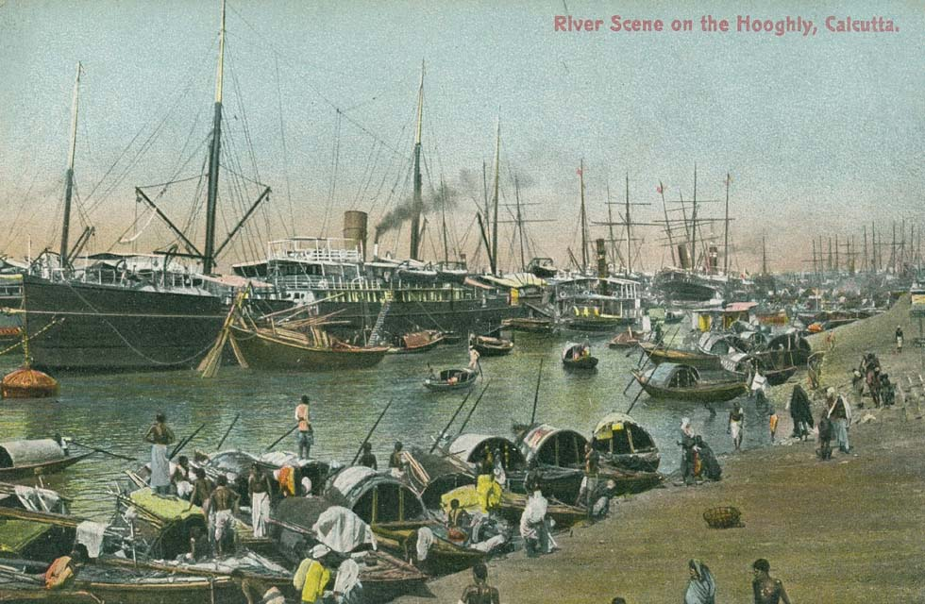
Notes:
The Farakka Barrage Project was formulated to serve the need of preservation and maintenance of the Calcutta Port by improving the regime and navigability of the Bhagirathi-Hoogly River system. As the Calcutta Port was located 120 kms north of the delta, it was never an ideal port for the movement of big vessels. Before the construction of the Calcutta Port, the Bhagirathi lost its connection from the main channel of the Ganges. From seventeenth century account of Jean-Baptiste Travernier we find that at Suti the main source of the Ganges was filled up with sand and sediment. ⁸ Between 1768 and 1777 the Bhagirathi almost remained dry in the winter months. ⁹ Jalangi and Mathabhanga were the alternative channel-routes for the movement of steamers. But these two channels also lost their importance in the last decade of the nineteenth century.

Slide 10
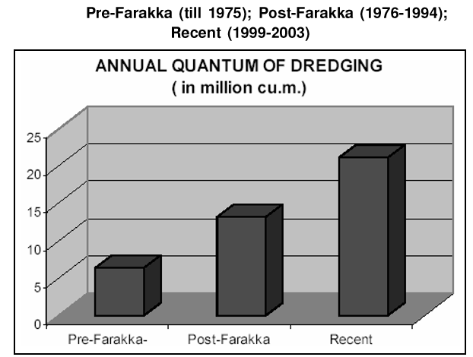
Is it a story of technical success?
sedimentation in the estuary continues unabated
annual quantum of dredging has increased from 6.40m.m3 during pre-Farakka days to 13.24m.m3 during post-Farakka days; 21.18m.m3 per annum during 1999-2003
Source: Rudra 2003
Notes:
The induced water through Ganges-Bhagirathi feeder canal was supposed to flush the sediment load from the estuary and keep the navigation channel free from siltation. But sedimentation in the estuary continues unabated. It is admitted in the published document of the Calcutta Port Trust that induced discharge from Farakka Barrage had not been able to negate the estuarine sedimentation. The annual quantum of dredging has increased from 6.40m.m3 during pre-Farakka days to 13.24m.m3 during post-Farakka days, which has further been increased to 21.18m.m3 per annum during 1999-2003.
The FBP has been a technical fiasco. Apart from these, there are immense social and environmental repercussions which we will focus in the next presentation.

Slide 11
References
http://fbp.gov.in (accessed on April 22, 2018).
Mirza, M. M. Q. (ed). 2004. The Ganges Water Diversion: Environmental Effects and Implications. Netherlands: Kluwer Academic Publishers. 5.
Mukherjee, J. 2011 No voice, no choice: Riverine changes and human vulnerability in the ‘chars’ of Malda and Murshidabad, Occasional Paper 28. Kolkata: Institute of Development Studies Kolkata.
Mukherjee, R. 2008-09. The Changing face of Bengal: A Study in Riverine Economy, with an introduction by Arun Bandopadhyay. Calcutta: University of Calcutta. 2.

Slide 12
References
Rudra, K. 1996. The Farakka Barrage Project – An interruption to fluvial regime. Indian Journal of Landscape System and Ecological Studies. Vol 19. 2.
Rudra, K. 2003. The Encroaching Ganga and Social Conflicts: The Case of West Bengal, India. Habra S.C. Mahavidyalaya (College), West Bengal, India.
Sherwill, W. S. 1858. Report on the rivers of Bengal. Calcutta Printing and Publishing Company, Calcutta. 17.
The Farakka Barrage (New Delhi: Ministry of External Affairs, 1978).

Slide 13


